Slide 1
Web Scrapping

Slide 2
Web Scraping (also termed Screen Scraping, Web Data Extraction, Web Harvesting etc.) is a technique employed to extract large amounts of data from websites whereby the data is extracted and saved to a local file in your computer or to a database in table (spreadsheet) format.

Slide 3
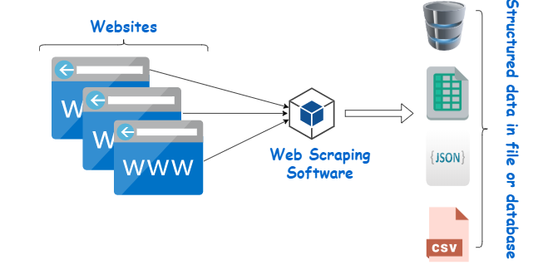

Slide 4
Web scraping is a technique for targeted, automated extraction of information from websites.
Similar extraction can be done manually but it is usually faster, more efficient and less error-prone to automate the task.
Web scraping allows you to acquire non-tabular or poorly structured data from websites and convert it into a usable, structured format, such as a .csv file or spreadsheet.
Scraping is about more than just acquiring data: it can also help you archive data and track changes to data online.

Slide 5
For example:
Online stores will periodically scour the publicly available pages of their competitors, scrape item names and prices and then use this information to adjust their own prices.
Marketing databases may be compiled by scraping contact information such as email addresses.

Slide 6
Applications
tracking trends in the real estate market by scraping data from real estate web sites
collecting online article comments and other discourse for analysis (e.g. using text mining)
gathering data on membership and activity of online organisations
collecting archives of reports from many web pages

